Slide 1
Predictive Maintenance (Tutorial)
University of Münster
Professional School
Master Data Science

Slide 2




A Closer Look at PHM Design
The General PHM Design Process
Reminder
Data Acquisition & Preparation
From raw to health data
Fault Detection & Diagnostics
Is there a fault?
Prognostics
What is the remaining useful life (RUL)?
Decision-making
What are resulting actions?
[based on Coble 2016; Guillén et al. 2016]

Slide 3
Agenda
01 | Data Acquisition & Preparation
02 | Fault Detection & Diagnostics
03 | Prognostics
04 | Decision-Making
05 | Exercise

Slide 4


01
Data Acquistion & Preparation

Slide 5
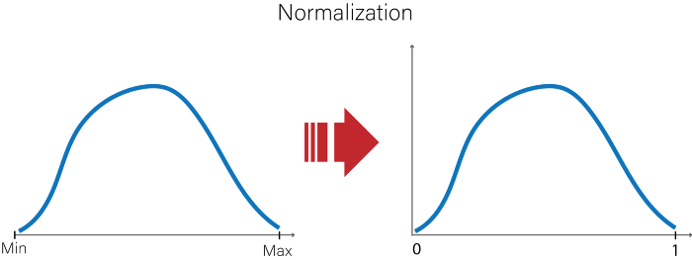
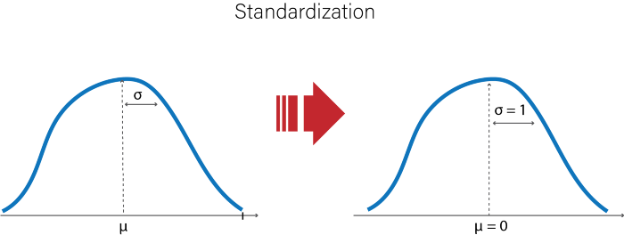
Feature Scaling I/II
Normalization vs. Standardization
[https://becominghuman.ai/feature-scaling-in-machine-learning-20dd93bb1bcb]

Slide 6
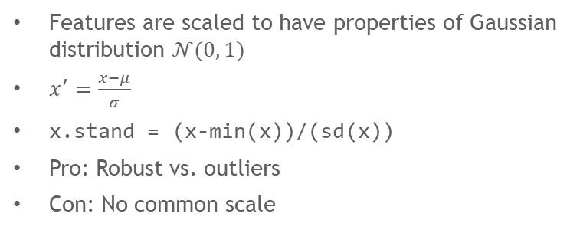
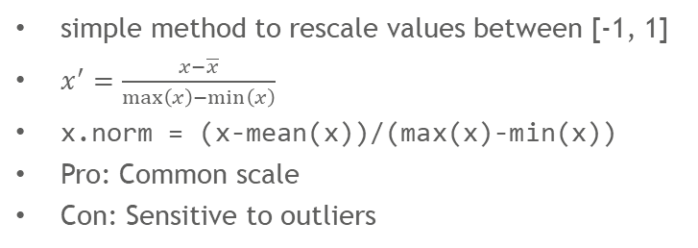
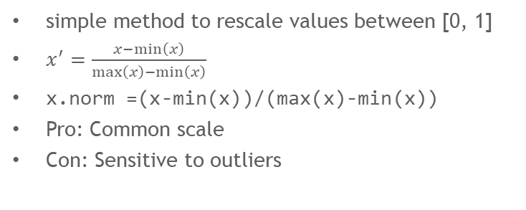
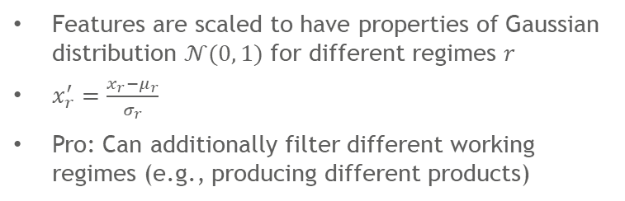
Feature Scaling II/II
Methods of Feature Scaling
Min-max normalization
Mean normalization
simple method to rescale values between [0, 1]
$x^{′}=\frac{x−\min\left(x\right)}{\max\left(x\right)−\min\left(x\right)}$
x.norm =(x-min(x))/(max(x)-min(x))
Pro: Common scale
Con: Sensitive to outliers
simple method to rescale values between [-1, 1]
$x^{′}=\frac{x−\overline{x}}{\max\left(x\right)−\min\left(x\right)}$
x.norm = (x-mean(x))/(max(x)-min(x))
Pro: Common scale
Con: Sensitive to outliers
Standardization
Multi-regime Standardization
Features are scaled to have properties of Gaussian distribution $𝒩(0, 1)$
$x^{′}=\frac{x−μ}{σ}$
x.stand = (x-min(x))/(sd(x))
Pro: Robust vs. outliers
Con: No common scale
Features are scaled to have properties of Gaussian distribution $𝒩(0, 1)$ for different regimes $r$
$x_{r}^{′}=\frac{x_{r}−μ_{r}}{σ_{r}}$
Pro: Can additionally filter different working regimes (e.g., producing different products)

Slide 7
Imputation
Simple Methods to Fill the Void
Original
Temperature | Vibration
10 | 300
10 | 200
20 | 200
20 | 80
30 | NA
na.rm = T
Temperature | Vibration
10 | 300
10 | 200
20 | 200
20 | 80
mean()
Temperature | Vibration
10 | 300
10 | 200
20 | 200
20 | 80
30 | 195
median()
Temperature | Vibration
10 | 300
10 | 200
20 | 200
20 | 80
30 | 200
min()
Temperature | Vibration
10 | 300
10 | 200
20 | 200
20 | 80
30 | 80
max()
Temperature | Vibration
10 | 300
10 | 200
20 | 200
20 | 80
30 | 300

Slide 8
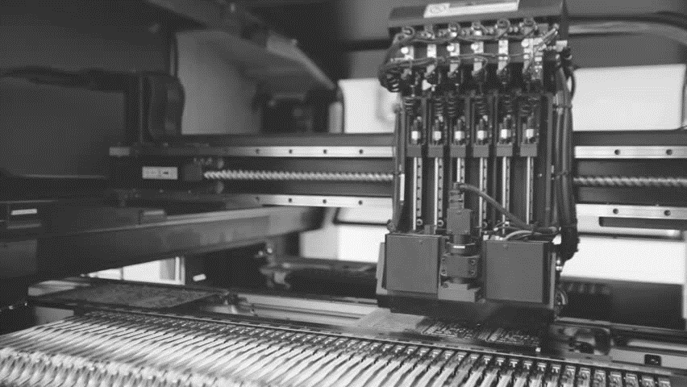
02
Fault Detection & Diagnostics

Slide 9
Fault Classification with SVMs
The Data-Driven Way
Reminder
viscosity
Micro-pitting
max
Adhesive wear
vibration

Slide 10
Reminder: MLR
The General Process
1
Define Task
task = makeClassifTask(data = bearing, target = “Fault")
lrn = makeLearner("classif.svm")
n = nrow(bearing)
train.set = sample(n, size = 2 / 3 * n)
test.set = setdiff(1:n, train.set)
2
Define Learner
3
Fit Model
model = train(lrn, task, subset = train.set)
4
Predict
pred = predict(model, task = task, subset = test.set)

Slide 11
Integrated Classifiers
What can be Used Out-of-the-Box
ada | adaboostm1 | bartMachine | binomial | boosting | bst | C50 | cforest | clusterSVM | ctree
cvglmnet | dbnDNN | dcSVM | earth | evtree | extraTrees | fdausc.glm | fdausc.kernel | fdausc.knn | fdausc.np
FDboost | featureless | fgam | fnn | gamboost | gaterSVM | gausspr | gbm | geoDA | glmboost
glmnet | h2o.deeplearning | h2o.gbm | h2o.glm | h2o.randomForest | IBk | J48 | JRip | kknn | knn
ksvm | lda | LiblineaRL1L2SVC | LiblineaRL1LogReg | LiblineaRL2L1SVC | LiblineaRL2LogReg | LiblineaRL2SVC | LiblineaRMultiClassSVC | linDA | logreg
lssvm | lvq1 | mda | mlp | multinom | naiveBayes | neuralnet | nnet | nnTrain | nodeHarvest
OneR | pamr | PART | penalized | plr | plsdaCaret | probit | qda | quaDA | randomForest
randomForestSRC | ranger | rda | rFerns | rknn | rotationForest | rpart | RRF | rrlda | saeDNN
sda | sparseLDA | svm | xgboost
[https://mlr.mlr-org.com/articles/tutorial/integrated_learners.html]

Slide 12
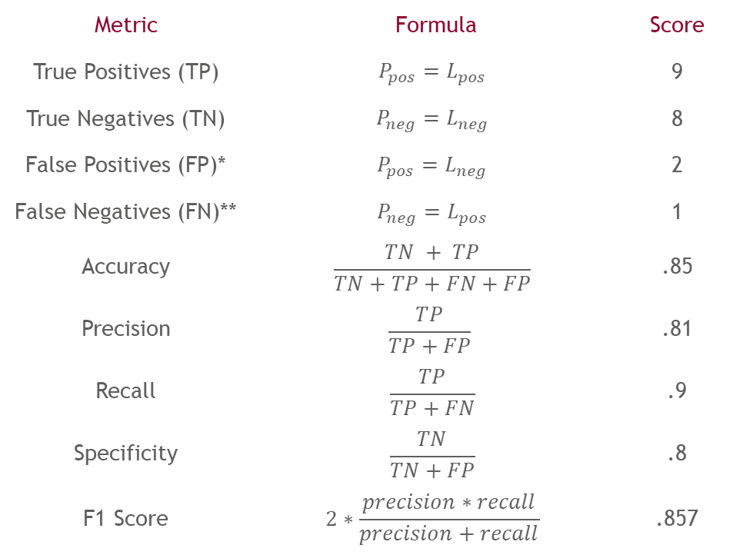
Fault Detection and Diagnostics Metrics
Measuring Success of Detecting Faults
Metric | Formula | Score
True Positives (TP) | $${P_{pos}=L}_{pos}$$ | 9
True Negatives (TN) | $${P_{neg}=L}_{neg}$$ | 8
False Positives (FP)* | $${P_{pos}=L}_{neg}$$ | 2
False Negatives (FN)** | $${P_{neg}=L}_{pos}$$ | 1
Accuracy | $$\frac{TN + TP}{TN+TP+FN+FP}$$ | .85
Precision | $$\frac{TP}{TP+FP}$$ | .81
Recall | $$\frac{TP}{TP+FN}$$ | .9
Specificity | $$\frac{TN}{TN+FP}$$ | .8
F1 Score | $$2∗\frac{precision∗recall}{precision+recall}$$ | .857
 | Pred neg | Pred pos
Label neg
Label pos
8
2
1
9
*Type I Error ** Type II Error
[Saxena et al. 2008]

Slide 13
Failure Cost Metrics
Over-maintenance vs. Unexpected Failures
What if some misclassifications are more expensive that others?
Predicting faults when the asset is healthy vs. predicting a healthy asset when there is a fault
 | Pred neg | Pred pos
Label neg
Label pos
1
Cost Matrix
costs = matrix(c(0, 1000, 100, 0), ncol = 2)
rownames(costs) = colnames(costs) = getTaskClassLevels(task)
8
2
Costs = 100
Measure Object
my.costs = makeCostMeasure(
id = "my.costs", name = "My Costs",
costs = costs,
minimize = TRUE, best = 0, worst = 1000
)
2
1
9
3
Evaluate
performance(pred, measures = my.costs)
Costs = 1000

Slide 14

03
Prognostics

Slide 15
Predicting Machine Degradation
A Look into the Crystal Ball
Reminder
Health
Failure threshold
Future
CM history
100%
0
Now
t

Slide 16
Integrated Regressors
What can be Used Out-of-the-Box
bartMachine | bcart | bgp | bgpllm | blm | brnn
bst | btgp | btgpllm | btlm | cforest | crs
ctree | cubist | cvglmnet | earth | evtree | extraTrees
FDboost | featureless | fgam | fnn | frbs | gamboost
gausspr | gbm | glm | glmboost | glmnet | GPfit
h2o.deeplearning | h2o.gbm | h2o.glm | h2o.randomForest | IBk | kknn
km | ksvm | laGP | LiblineaRL2L1SVR | LiblineaRL2L2SVR | lm
mars | mob | nnet | nodeHarvest | pcr | penalized
plsr | randomForest | randomForestSRC | ranger | rknn | rpart
RRF | rsm | rvm | svm | xgboost
[https://mlr.mlr-org.com/articles/tutorial/integrated_learners.html]

Slide 17
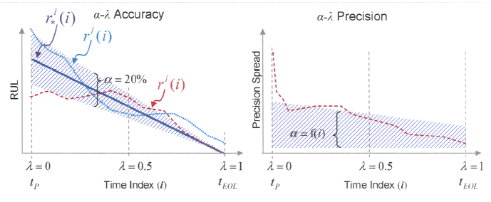
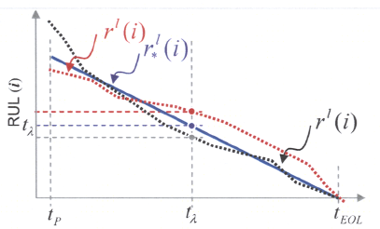
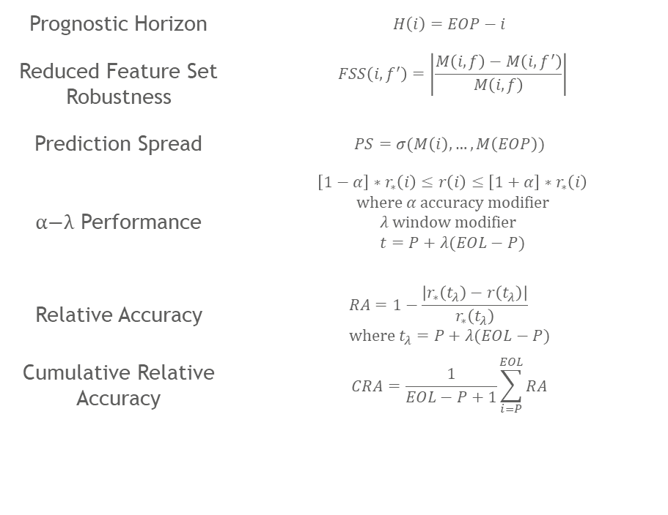
Prognostics Metrics*
It’s not About Whether we are Right, but About How Wrong we are
Prognostic Horizon | $$H\left(i\right)=EOP−i$$
Reduced Feature Set Robustness | $$FSS\left(i, f^{′}\right)=\left|\frac{M\left(i, f\right)−M\left(i,f^{′}\right)}{M\left(i, f\right)}\right|$$
Prediction Spread | $$PS=σ(M\left(i\right),…, M\left(EOP\right))$$
$\text{α}\text{−}\text{λ}$ Performance | $$\left[1−α\right]∗r_{∗}\left(i\right)≤r\left(i\right)≤\left[1+α\right]∗r_{∗}\left(i\right)$$ $$\text{where} α \text{accuracy} \text{modifier}$$ $$λ \text{window} \text{modifier} \\ t=P+λ(EOL−P)$$
Relative Accuracy | $$RA=1−\frac{\left|r_{∗}\left(t_{λ}\right)−r\left(t_{λ}\right)\right|}{r_{∗}\left(t_{λ}\right)} \\ \text{where} t_{λ}=P+λ(EOL−P)$$
Cumulative Relative Accuracy | $$CRA=\frac{1}{EOL−P+1}\sum_{i=P}^{EOL}{RA}$$
*EOP: End of Prediction, i: time index of observation, M: any performance metric (e.g., error), f(‘): (reduced) feature set, r: Actual RUL, r*: Forecasted RUL, EOL: end of life, P: time point of prediction
[Saxena et al. 2008]
Notes:
Prognostic Horizon: This metric is mentioned in the "Electronics Prognostics R&D Needs Definition" presentation [49], but not explicitly defined. We suggest the following definition: Prognostic Horizon is the difference between the current time index i and EOP utilizing data accumulated up to the time index provided the prediction meets desired specifications
Reduced Feature Set Robustness: Calculates the effect of an arbitrarily reduced feature set on M This metric does not make a distinction between the essential features of a feature set and the more ancillary ones (as pertinent to the algorithm under consideration). is simply meant to provide a common way to perform quantitative assessment of the consequences of feature (or features) removal. For instance, loss of signal from an an actuator vibration sensor may make the accuracy of RUL estimates unacceptable, while loss of the ambient pressure sensor could still allow useful predictions to be made. In certain fields, such as military aerospace, the tolerance of an algorithm to sensor loss is likely to be an important consideration
Prediction Spread: This quantifies the variance of prediction over time for any UUT can be computed over any accuracy or precision based metric
$\text{α}\text{−}\text{λ}$ Performance: Prediction accuracy at specific time instances; e.g., demand accuracy of prediction to be within $\text{α}$*100% after fault detection some defined relative distance $\text{λ}$ to actual failure. For example, 20% accuracy (i.e., $\text{α}$=0.2) halfway to failure after fault detection (i.e., $\text{λ}$=0.5).
Relative Accuracy: Relative prediction accuracy at specific time instances
Cumulative Relative Accuracy: Normalized sum of relative prediction accuracies at specific time instances.

Slide 18

04
Decision-Making

Slide 19

Decision-Making Algorithms
Exploit problem-specific knowledge
Methods | Problem-specific
Pros | Fast, tuned to a specific problem
Cons | Not optimal
R | heuristica
Guarantee finding an optimal solution
Methods | Mathematical Programming, Exhaustive Search, Branch and Bound, Dynamic Programming
Pros | Optimal
Cons | Long computation time
R | ompr, deoptim, nlsr
Heuristics
01
Reinforcement Learning
04
02
Exact Methods
Learns to map states to actions to maximize reward
Methods | Monte Carlo, Temporal Difference Learning
Pros | Can solve complex problems
Cons | Markov assumption, a lot of computations, not optimal
R | ReinforcementLearning, gym
Sample a subset of solutions
Methods | Genetic Algorithm, Simulated Annealing, Particle Swarm Optimization
Pros | Generalizable to many problems
Cons | No optimal solution
R | metaheuristicOp
03
Metaheuristics
[Rothlauf 2011, Sutton & Barto 2018]

Slide 20
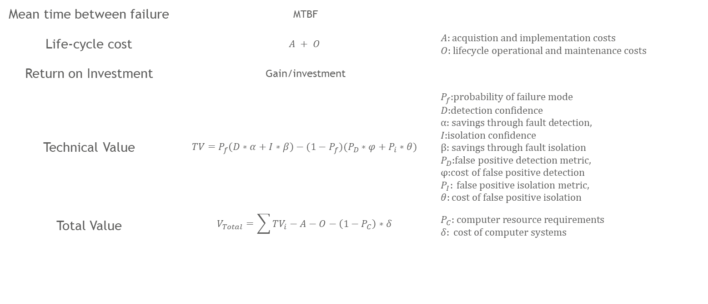
Economic Metrics
How to Measure Success of PHM Decision-Making?
Mean time between failure | MTBF
Life-cycle cost | $$A + O$$ | $$A:\text{acquistion} \text{and} \text{implementation} \text{costs} \\ O\text{: }\text{lifecycle} \text{operational} \text{and} \text{maintenance} \text{costs}$$
Return on Investment | Gain/investment
Technical Value | $$TV=P_{f}\left(D∗α+I∗β\right)−(1−P_{f})(P_{D}∗φ+P_{i}∗θ)$$ | $$P_{f}\text{:}\text{probability} \text{of} \text{failure} \text{mode} \\ D\text{:}\text{detection} \text{confidence} \\ α\text{: }\text{savings} \text{through} \text{fault} \text{detection}\text{,} \\ I\text{:}\text{isolation} \text{confidence} \\ β\text{: }\text{savings} \text{through} \text{fault} \text{isolation} \\ P_{D}\text{:}\text{false} \text{positive} \text{detection} \text{metric}\text{,} \\ φ\text{:}\text{cost} \text{of} \text{false} \text{positive} \text{detection} \\ P_{I}: \text{false} \text{positive} \text{isolation} \text{metric}\text{,} \\ θ:\text{cost} \text{of} \text{false} \text{positive} \text{isolation}$$
Total Value | $$V_{Total}=\sum{TV_{i}−A−O−\left(1−P_{C}\right)∗δ}$$ | $$P_{C}\text{: }\text{computer} \text{resource} \text{requirements} \\ δ: \text{cost} \text{of} \text{computer} \text{systems}$$
[Saxena et al. 2008]
Notes:
MTBF: This metric measures the ratio between how long a component lasts and how long it is used before replacing it. Prognostics should enable the reduction of this ratio by allowing components to be used longer~ until they are closer to failure~ which would save money.
Life-cycle cost: As a metric~ compare the life cycle cost of the system (which includes the cost of building it or acquiring it and the cost of operating it) with and without prognostics. Total Value is the change in life cycle cost. ROJ will be positive if adding prognostics reduces life cycle cost
Return on Investment (ROI): An investment in prognostics is expected to save money on maintenance and possibly prevention of downtime or lost hardware over the life of the system. The gain is the amount of money saved as a result of using prognostics (that is, the reduction in life-cycle cost)~ and the investment is the cost of developing, installing, and maintaining the prognostic system. The ROI (which is usually annualized) can be seen as the interest rate that a bond would have to pay to provide the same financial return. An investment should only be made if its ROI is at least as high as those of other potential investments with similar risk.
Technical Value: The benefits achieved through accurate detection, fault isolation and prediction of critical failure modes are weighed against the costs associated with false alarms, inaccurate diagnoses/prognoses, and resource requirements of implementing and operating specific techniques
Total Value: Describes the value of a PHM technology in a particular application as the summation of the benefits it provides over all the failure modes that it can diagnose or prognose less the implementation cost, operation and maintenance cost, and consequential cost of incorrect assessments

Slide 21

05
Exercise

Slide 22

APS Failure at Scania Trucks I/II
Introduction
Data Set
Data collected from heavy Scania trucks in everyday usage
System in focus is Air Pressure system (APS) generates pressurized air utilized in various functions in truck, such as braking and gear changes.
Positive class: failures for a specific component of the APS system
Negative class: trucks with failures for components not related to APS
Data consists of a subset of all available data, selected by experts.
60,000 examples in train data set, 16,000 examples in test data set, 171 Attributes
[Dua & Graff 2019]
Notes:
The total cost of a prediction model the sum of "Cost_1" multiplied by the number of Instances with type 1 failure and "Cost_2" with the number of instances with type 2 failure, resulting in a "Total_cost".
In this case Cost_1 refers to the cost that an unnessecary check needs to be done by an mechanic at an workshop, while Cost_2 refer to the cost of missing a faulty truck, which may cause a breakdown.
Total_cost = Cost_1*No_Instances + Cost_2*No_Instances.

Slide 23
APS Failure at Scania Trucks II/II
Introduction
Costs
Attributes
Structure: Class, then 171 operational data attributes
Attribute names have been anonymized
Single numerical counters (101) and histograms (7*10) consisting of bins with different conditions
Attributes have identifier (e.g., aa_000), histogram variables have additional incremental bin identifier (e.g., ag_000, ag_001, etc.)
Histograms have open-ended conditions at each end. For example if we measuring the ambient temperature "T" then histogram could be defined with 4 bins where:
bin 1 collect values for temperature T < -20
bin 2 collect values for temperature T >= -20 and T < 0
bin 3 collect values for temperature T >= 0 and T < 20
bin 4 collect values for temperature T > 20
Missing values are denoted by the string "na".
 | Pred neg | Pred pos
Label neg
Label pos
Cost I = 10
0
Cost II = 500
0
[Dua & Graff 2019]
Notes:
The total cost of a prediction model the sum of "Cost_1" multiplied by the number of Instances with type 1 failure and "Cost_2" with the number of instances with type 2 failure, resulting in a "Total_cost".
In this case Cost_1 refers to the cost that an unnessecary check needs to be done by an mechanic at an workshop, while Cost_2 refer to the cost of missing a faulty truck, which may cause a breakdown.
Total_cost = Cost_1*No_Instances + Cost_2*No_Instances.

Slide 24
Exercise
What You Have to Do
Conceive a PHM design using the process presented in the lecture. Design and program a cost-optimal prediction algorithm using the Scania data set while fulfilling the following tasks. Note: Use the whole data set unless stated otherwise.
Normalize the attributes using a min-max normalization.
Calculate the share of NA values per attribute. Remove attributes with >5% of NA values. Impute the NA values for the other attributes using the median.
Train a decision tree fault detection model (by using classif.rpart from the mlr package) on the train data set and detect APS faults for the test data set.
Calculate the performance of your fault detection algorithm for the test data set using the custom cost metric introduced on the last slide.
Optional: Extend your PHM design by thinking about further improvements. Optimize your fault detection algorithm using the extended design.

Slide 25
Literature
Dua, D. and Graff, C. (2019). UCI Machine Learning Repository [http://archive.ics.uci.edu/ml]. Irvine, CA: University of California, School of Information and Computer Science.
Rothlauf, F.: Optimization Methods. In: Rothlauf, F. (ed.) Design of Modern Heuristics. Natural Computing Series, pp. 45–102. Springer Berlin Heidelberg, Berlin, Heidelberg (2011). doi: 10.1007/978-3-540-72962-4_3
Saxena, A., Celaya, J., Balaban, E., Goebel, K., Saha, B., Saha, S., Schwabacher, M.: Metrics for evaluating performance of prognostic techniques. In: 2008 International Conference on Prognostics and Health Management, PHM 2008, 1-17 (2008)
Sutton, R.S., Barto, A.: Reinforcement learning. An introduction. The MIT Press, Cambridge, Massachusetts, London, England (2018)

Slide 27
Descriptive Exploratory Data Analysis
How to Get to Know the Data
General
Numeric
Categorical
Number of observations: nrow()
Number of features: ncol()
Feature names: colnames()
Dimensions: dim()
Types: str()
Missing values: is.na()
Outliers: hist(), boxplot()
Data: head(), tail()
Location (e.g., min, mean, median, quantiles, max): boxplot(), summary()
Spread (e.g., variance, standard deviation): var(), sd(), moment(), skewness(), kurtosis()
Relation (e.g., covariance, correlation): cov(), cor()
Levels: levels()
Distribution: table()

Slide 28
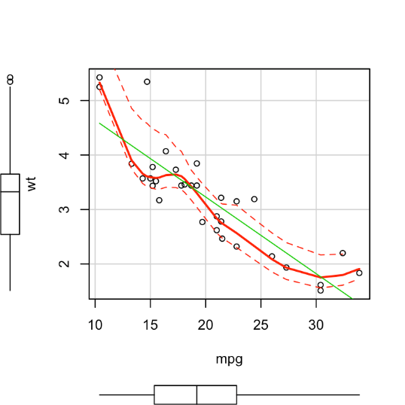
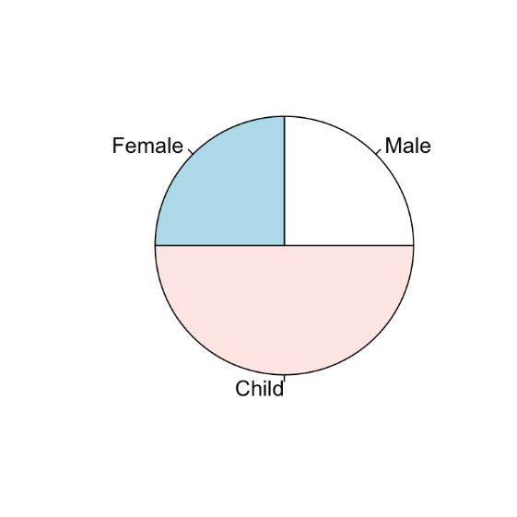
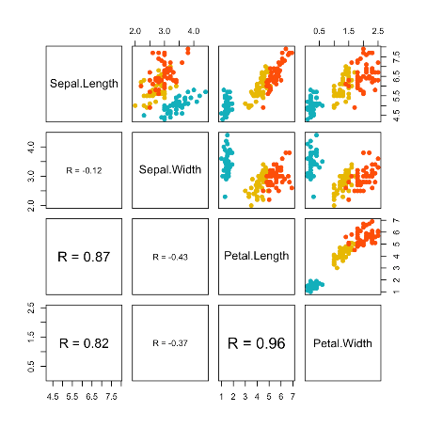
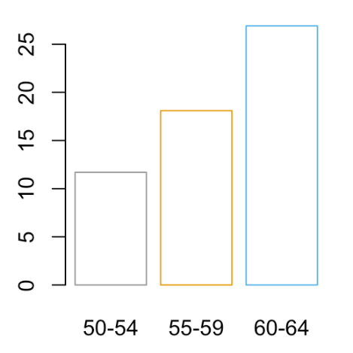
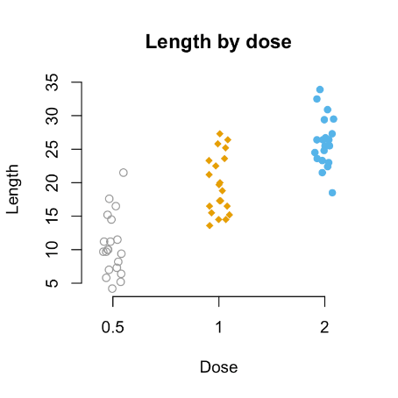
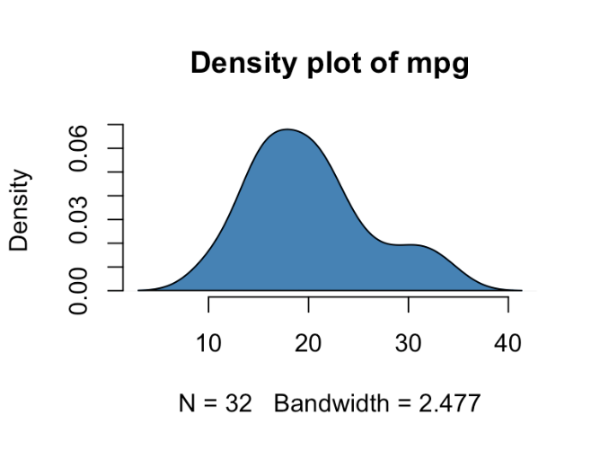
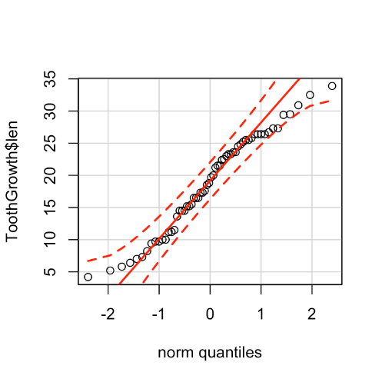
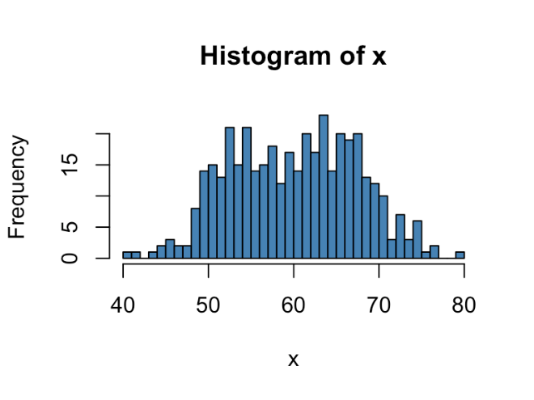
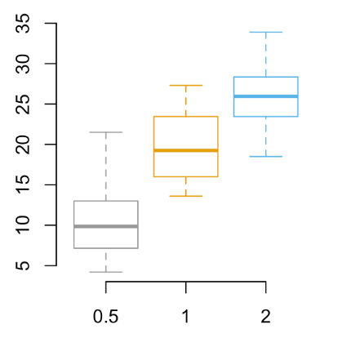
Visualization
Base R Plots
plot()
pairs()
barplot()
pie()
stripchart()
boxplot()
hist()
density()
qqplot()
[http://www.sthda.com/english/wiki/r-base-graphs]

Slide 29
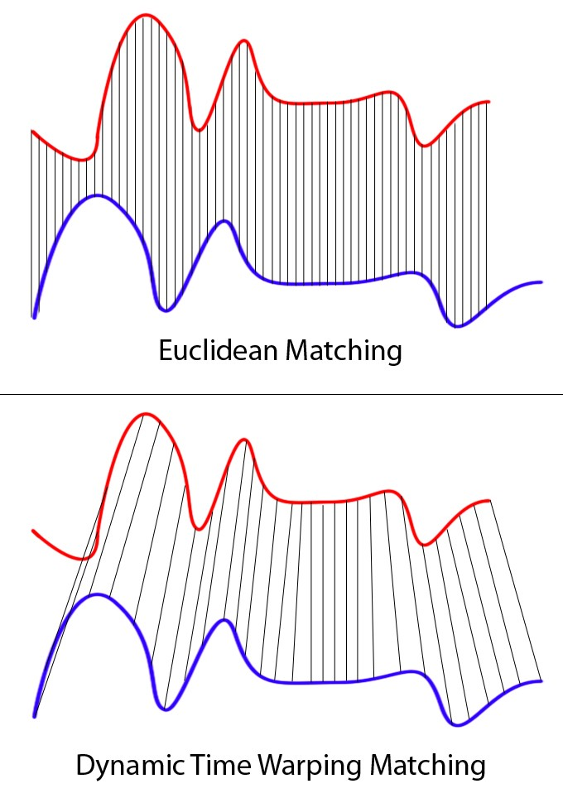
Dynamic Time Warping
How to Match Different Degradation Patterns
Time series (e.g., degradation, sensor values) analysis algorithm for measuring similarity between two temporal sequences, which may vary in speed and length
Match index from first series 1 to n indices from other series and vice versa. Optional: Add locality (e.g., window) constraint to limit number of matches
First index from first series matched with first index from other series
Last index from first series matched with last index from other series
Monotonically increasing mapping, no crossover
Optimal match = satisfies steps 1 to 4 and has lowest cost
Optional: Warp time series to be aligned
R Package: dtw at https://dynamictimewarping.github.io/
[https://towardsdatascience.com/dynamic-time-warping-3933f25fcdd]

Slide 30
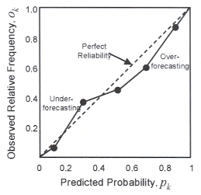
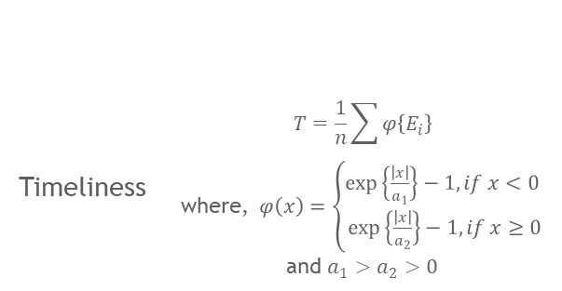
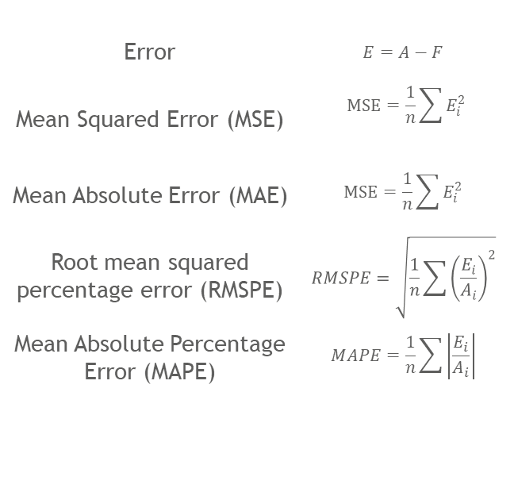
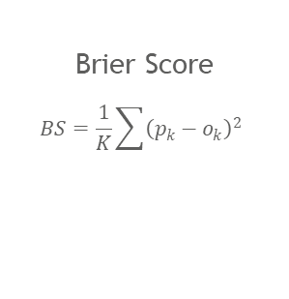
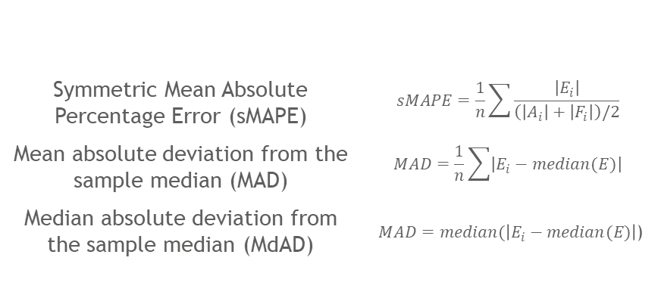
Traditional Prognostics Metrics*
It’s not About Whether we are Right, but About How Wrong we are
Error | $$E=A−F$$
Mean Squared Error (MSE) | $$MSE=\frac{1}{n}\sum{E_{i}^{2}}$$
Mean Absolute Error (MAE) | $$MSE=\frac{1}{n}\sum{E_{i}^{2}}$$
Root mean squared percentage error (RMSPE) | $$RMSPE=\sqrt{\frac{1}{n}\sum{{\left(\frac{E_{i}}{A_{i}}\right)}^{2}}}$$
Mean Absolute Percentage Error (MAPE) | $$MAPE=\frac{1}{n}\sum{\left|\frac{E_{i}}{A_{i}}\right|}$$
Symmetric Mean Absolute Percentage Error (sMAPE) | $$sMAPE=\frac{1}{n}\sum{\frac{\left|E_{i}\right|}{\left(\left|A_{i}\right|+\left|F_{i}\right|\right)/2}}$$
Mean absolute deviation from the sample median (MAD) | $$MAD=\frac{1}{n}\sum{\left|E_{i}−median(E)\right|}$$
Median absolute deviation from the sample median (MdAD) | $MAD=median(\left|E_{i}−median(E)\right|$)
Brier Score
$$BS=\frac{1}{K}\sum{{\left(p_{k}−o_{k}\right)}^{2}}$$
Timeliness | $$T=\frac{1}{n}\sum{φ\left\{E_{i}\right\}}$$ where, $φ\left(x\right)=\left\{\begin{aligned}\exp\left\{\frac{\left|x\right|}{a_{1}}\right\}−1, if x<0 \\ \exp\left\{\frac{\left|x\right|}{a_{2}}\right\}−1, if x≥0\end{aligned}\right.$ and $a_{1}>a_{2}>0$
*A: Actual RUL, F: Forecasted RUL, n: number of observations (e.g., time steps, assets), i: index of observation
[Saxena et al. 2008]
Notes:
Error: Error defines the basic notion of deviation from desired output. Most accuracy based metrics are derived directly or indirectly from error
MSE: Averages the squared prediction error for multiple assets at the same prediction horizon. A derivative of MSE is Root Mean Squared Error (RMSE)
MAE: Averages the absolute prediction error for multiple assets at the same prediction horizon. Using median instead of mean gives median absolute error (MdAE)
RMSPE: Square root of the average of percentage error of the prediction from multiple assets. A similar metric is Root median squared percentage error (RMdSPE).
MAPE: Averages the absolute percentage errors in the predictions of multiple assets at the same prediction horizon. Instead of the mean, median can be used to compute Median absolute percentage error (MdAPE) in a similar fashion
Timeliness: Exponentially weighs RUL prediction errors through an asymmetric weighting function. Penalizes the late predictions more than early predictions
sMAPE: Averages the absolute percentage errors in the predictions of multiple units at the same prediction horizon. The percentage is computed based on the mean value of the prediction and ground truth. This prevents the percentage error from being too large for the cases where the ground truth is close to zero.
MAD: This is a resistant estimator of the dispersion/spread of the prediction error. It is intended to be used where there is a small number of assets and when the error plots do not resemble those of a normal distribution.
MdAE: This is a resistant estimator of the dispersion/spread of the prediction error. It is intended to be used where there is a small number of assets and when the error plots do not resemble those of a normal distribution.
Brier Score: The reliability diagram plots the observed frequency against the predicted probability of a random event. In prognostics, an event may be the RUL of a system in a given interval.

